Slide 1
Design Patterns

Slide 2
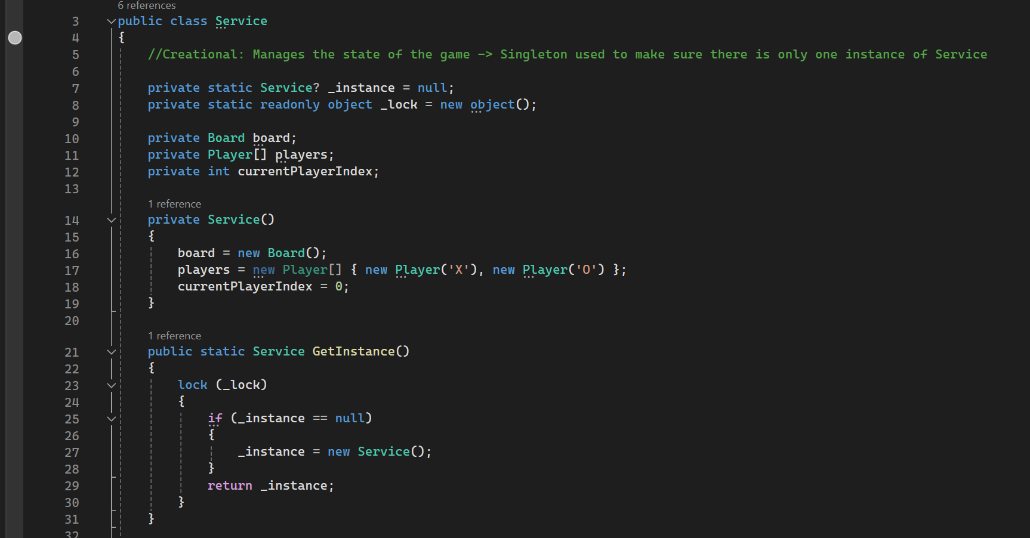
Creational: Singleton
Code

Slide 3
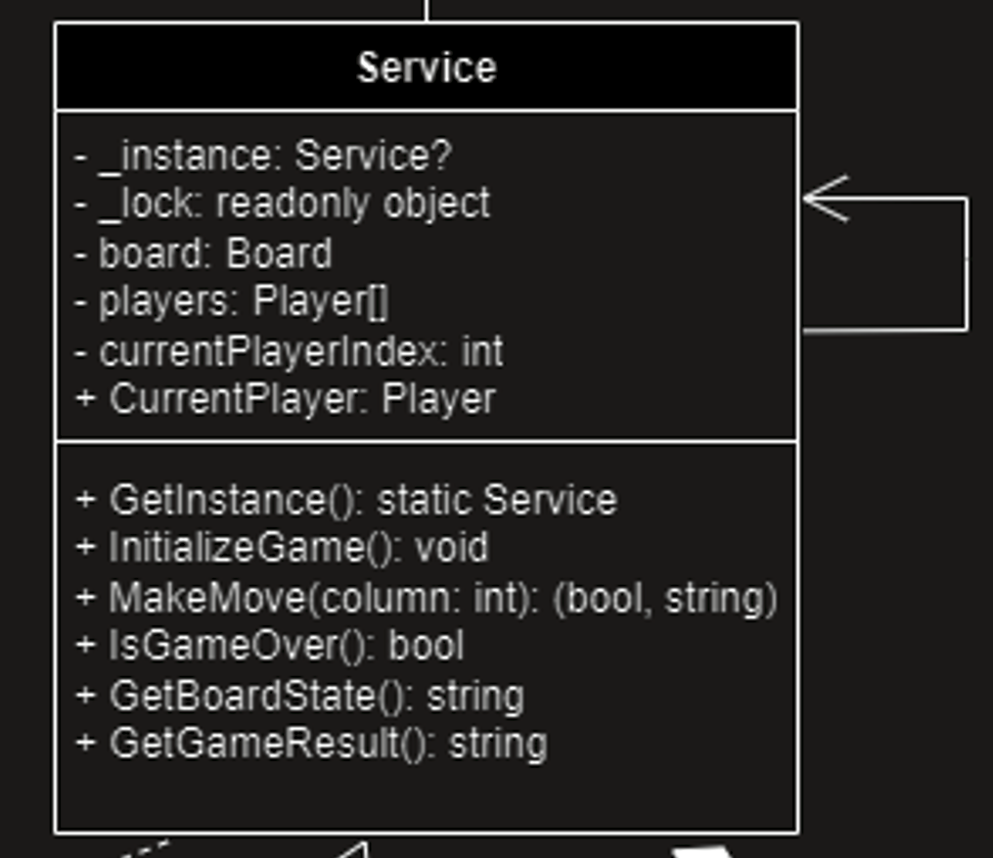
UML

Slide 4
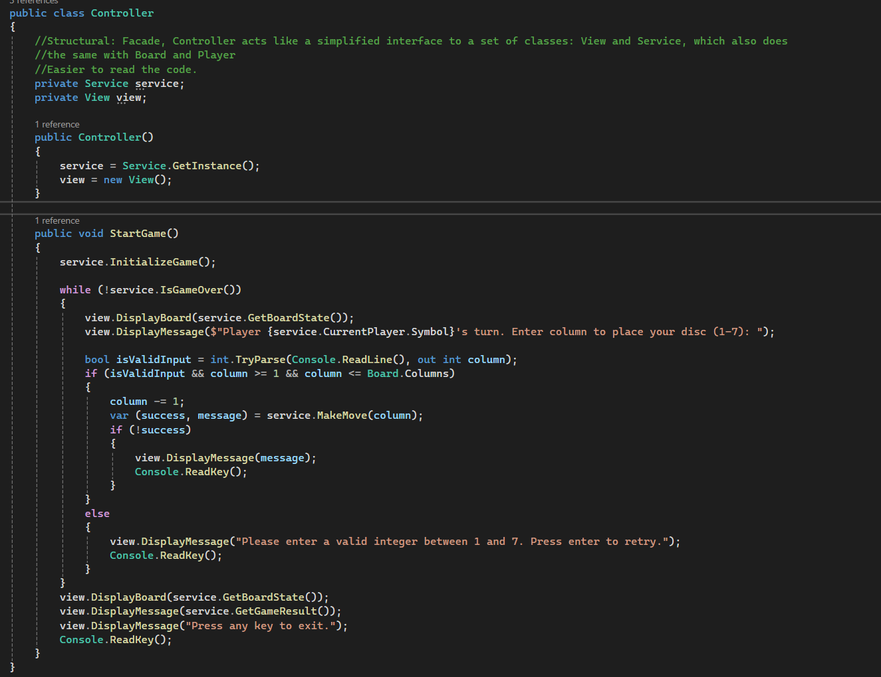
Structural: Facade
Code

Slide 5
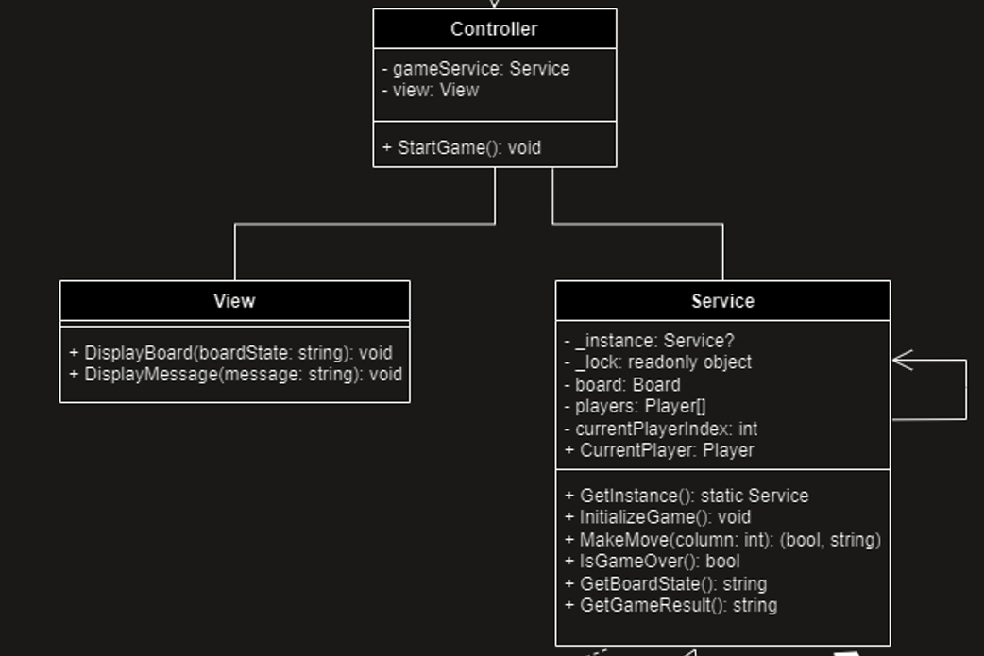
UML

Slide 6
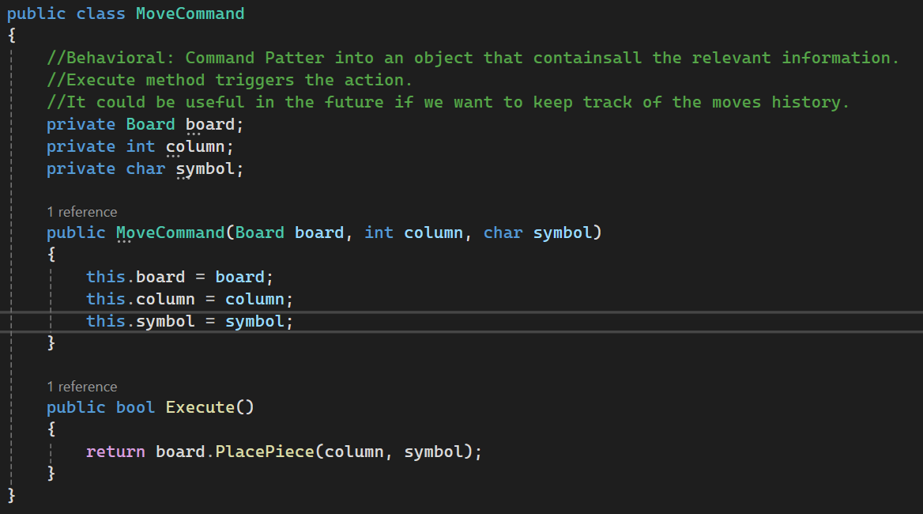
Behavioral: Command
Code

Slide 7
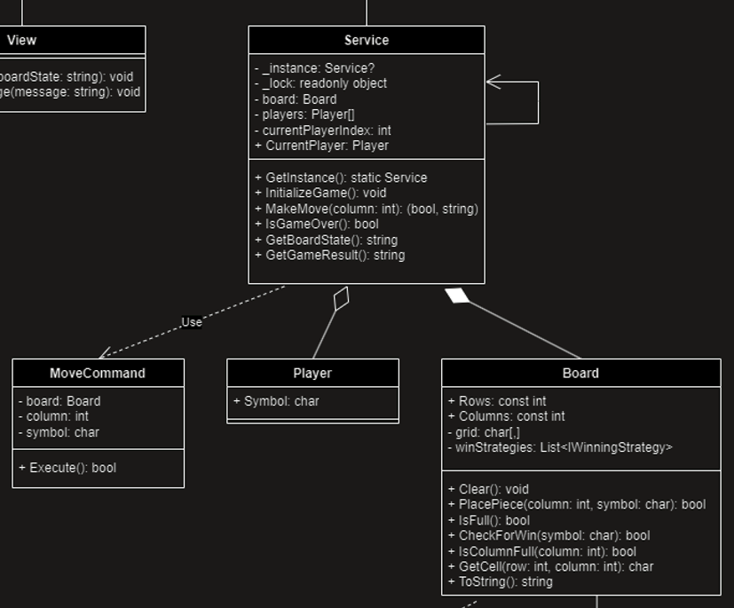
UML

Slide 8

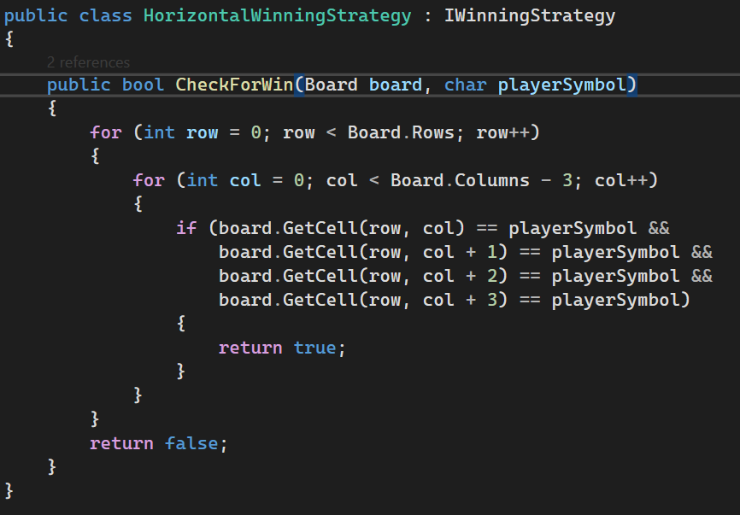
Behavioral: Strategy
Code

Slide 9

UML

Slide 10
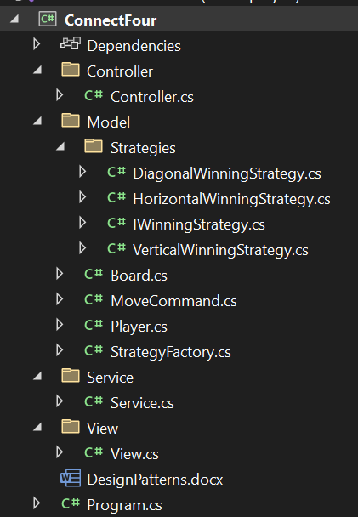
Architectural: MVCS

Slide 11
